Slide 1
Data Modeling and ER Diagrams
Dr. Sonal Dekhane
ITEC 3200

Slide 2
Review Pre-class activity, part I

Slide 3
Challenges
Difference between entities, attributes, and identifiers
I want to store data about students in my college
Notations and reading them
We will practice!
Create a cheat sheet for remembrance for now
Non-identifying vs. identifying relationships
One entity cannot exist without another
No room, if no building
No section, if no course

Slide 4
Challenges
Entity classes vs. instances
Classes encapsulate the common properties and behaviors
Person class vs. John Doe

Slide 5
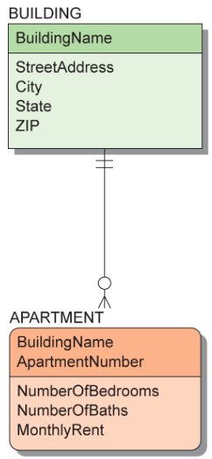
ID-Dependent Entity
Rounded box
Solid line/connector
Identifier of strong entity is part of identifier of weak entity

Slide 6
Class Activity
Work with a partner
Answer as many questions as you can
Use textbook and/or slides for reference
No Google or other such sites
We will review as a class together later

Slide 7
Practice
Go to review questions at the end of chapter 4 and complete the following:
4.17
4.18
Using crow’s foot notation, draw an ER diagram showing the following relationship:
Each agent can have many clients, but may not have any clients
Each client can have only one agent and should have at least one agent
Using crow’s foot notation, draw an ER diagram showing the following relationship:
Each client can see many properties and has to see at least one
Each property can be seen by many clients and has to be seen by at least one

Slide 8
Practice
Using crow’s foot notation draw the following relationship:
Each property can either be residential or commercial
Irrespective of their type, they all have a property ID used to identify them
They all have a street address, city, state and zip code
In addition, residential properties have a type (condo, townhome, etc.), number of bedrooms and number of bathrooms
Commercial properties have number of units available and rent

Slide 9
Pre-class activity, part II

Slide 10
Complete part B
Turn in your diagram for points

